Slide 1
Unsheltered Point in Time Count (PITC)
Coordinator Training
MO BoS CoC PITC 2025

Slide 2
PIT Count 101
PIT Count 101
Street Count
What is the PIT Count?
Who is counted in the PIT Count?
Where are people counted?
Why do we do a PIT Count?
FAQs
Service Based Count
Survey
Resources

Slide 3
What is the Point in Time Count (PITC)?
PIT Count 101
A literal count of all the people experiencing homelessness in our community on a single night (i.e., at a point in time)
Conducted by our community in the last 10 days of January every year
A “snapshot” of homelessness on this one night in our community

Slide 4
Purpose:
PIT Count 101
We want to understand the total number of homeless people and some demographic information about them. Because all information is collected on a night, it doesn’t tell us everything about who experiences homelessness in our region, but it does give us a picture of our community, and offers a means of comparing info form this night year after year. Some of the data we collect is required by the U.S. Department of Housing and Urban Development, or HUD, and some of it is information that we as a community want to know to help us understand how well we’re serving people. The required information is ultimately reported to HUD by every community nationwide, so the surveys we ask you to complete with are linked directly to the data we have to report.

Slide 5
PIT Count 101
Who is counted?
The U.S. Department of Housing and Urban Development’s (HUD’s) definition of “homeless,” for the purpose of the PIT count, includes two main types of homelessness:
Unsheltered: Individuals or families whose primary nighttime residence is a place not meant for human habitation
Sheltered: Individuals or families residing in a place dedicated to serving people who would otherwise be unsheltered

Slide 6
PIT Count 101
Who is not counted?
Individuals in jails, detox facilities, hospitals, crisis centers, and rehabilitative programs that do not require or verify homelessness for services
Individuals who are temporarily staying with friends or who are paying for their own hotel
Individuals living in RV’s or tiny homes, unless they are not regularly connected to water, sewer, and utilities

Slide 7
PIT Count 101
Where are people counted?
Unsheltered PIT Count
Sheltered PIT Count
Parks
Cars
Abandoned building
Bus or train station
Laundromats
Camping ground
Parking Lot
Service Events
Emergency shelters (including overnight cold weather shelters and hotel/motel vouchers paid for by churches or non-profits)
Transitional Housing
Safe Havens
Today’s training will focus on the Unsheltered Count!

Slide 8
PIT Count 101
Note about the Sheltered Count:
For any questions about the Sheltered PIT, including whether any non-HMIS projects in your community that should be included in the count, please visit the ICA Missouri Knowledge Base or reach out to ICA directly:
HMIS System Administrators
Training for Sheltered PIT
Regions 1, 6, 7, 8, 9, and 10: Georgie Reedy, georgie.reedy@icalliances.org
Regions 2, 3, and 5: Ben Cohen, ben.cohen@icalliances.org
Region 4: Diana Kilguss, diana.kilguss@icalliances.org
If you are unsure of your region, please reach out to the ICA Missouri Help Desk at mohmis@icalliances.org
ICA will hold two live training webinars for the Sheltered PIT (with a recording available on the Knowledge Base after):
Thursday, 1/9/25 11am-12:30pm
Thursday, 1/9/25 3:30-5pm
ICA will also hold two drop-in office hours to answer questions related to the Sheltered PIT:
Wednesday, 1/15/25 10:00am-11:00am
Tuesday, 1/21/25 12:30pm-1:30pm

Slide 9
PIT Count 101
Why do we do a Point in Time Count?
It is about people
It is about data
It is about compliance
To help our community understand what resources we need and strategize the best ways to use them to end homelessness
To measure and monitor trends and changes in homelessness on local and national level
To comply with federal regulations and grant requirements

Slide 10
PIT Count 101
Frequently Asked Questions
Why in the winter?
Does it have to be at night?
How do we conduct an unsheltered PIT Count?
When do we count?
Who do we count?
Who do we NOT count?
What constitutes sheltered vs unsheltered?

Slide 11
PIT Count 101
FAQ: Why does the Point In Time Count take place
during the winter months?
Same timeframe for every community ensures consistency across the U.S.
Same timeframe year after year ensures that trends are monitored appropriately
Set for a night in winter because then each CoC is likely maximizing its resources to serve people's needs. Thus, this timing can provide a more precise picture of who is unable to access emergency shelter or other crisis response assistance.
End of the month to ensure that people who can only pay for temporary housing for part of the month are generally included in the count. For example, some people can afford to stay in a motel, but only for the first few weeks after receiving their public benefits payment at the beginning of the month

Slide 12
PIT Count 101
FAQ: Why do we have to do the PIT count at night?
The PIT count is a count of where people are sleeping on the night designated for the count. If we sent volunteers out before nighttime, we would not get the most accurate data for a few reasons.
There may be people who will sleep in unsheltered locations who are not yet out for the night.
We want to capture people’s actual sleeping arrangement, not where they plan to sleep at a future time.
Notes:
“Many people wonder why we conduct the PIT count at night. In short, it’s because our data quality won’t be as good if we do it, for instance, in the afternoon or evening and ask about where people will sleep that night. There are a few reasons for this:
First, there may be people who will sleep in unsheltered locations who are not yet out for the night. Perhaps they work during the day or spend daylight hours elsewhere for another reason.
Second, we do not want to ask people where they plan to sleep at a future time, even if that time is only a few hours away. Plans can change, and we want to make sure we’re getting the most accurate information possible.
Finally, many people who meet HUD’s definition of experiencing homelessness may not “look” the way many people assume those experiencing homelessness must look. So, during daylight hours, when it would be impossible to survey every single person who’s out and about, we might overlook them. At night, it is more reasonable to interview everyone who is out, regardless of whether they “look” homeless or not. We’ll talk more about what we mean by this part later on in the training.”

Slide 13
PIT Count 101
FAQ: How do we conduct an unsheltered PIT count?
Street Count
Interview on the Night of the Count (January 22 @5pm-January 23 @7am)
Service -Based Count
In-person events
Phone
after the ‘Street Count’ window is closed
Take place the 7 days following the Count
All surveys are to be conducted in person to person interview style. Do not hand the client a paper copy of the survey to complete on their own
For in person events with incentives, do not force client to complete the survey before gaining access to resources
Notes:
County Coordinators coordinate volunteers to perform the survey and ensure surveys are completed accurately and submitted on-time
Web-based survey helps quickly submit data. Paper forms will be made available if internet service is not available in remote areas.

Slide 14
PIT Count 101
FAQ: When do we count?
January 22, 2025
@5pm
January 23, 2025
@7am
Street Count
Asking: “Where will you sleep tonight?”
Asking: “Where did you sleep last night?”
Service Based Count
After 7am on the 24th to 31st
Asking: “Where did you sleep on Wednesday night?”
*Note it is not recommended to ask interviewees more that 2-3 days after the count to complete a survey, as they may not remember correctly and could skew the data collection

Slide 15
PIT Count 101
FAQ: Who to count?
Unsheltered Homeless Definition
“Individuals and families with a primary nighttime residence that is a public or private place not designed for or ordinarily used as a regular sleeping accommodation for human beings, including a car, park, abandoned building, bus or train station, airport, or camping ground”

Slide 16
PIT Count 101
FAQ: Who to NOT count?
People engaged in dangerous activities
Your safety is number one priority
People residing in institutions (e.g. jails, juvenile correction facilities, foster homes, hospitals, in-patient treatment centers)
“Doubling Up/ Couch Surfing”:
Survey will end at question, “Where did you sleep the night of the PITC?” if the answer is “couchsurfing/doubling up”

Slide 17
PIT Count 101
FAQ: What constitutes sheltered vs unsheltered?
Clients provided with planned sleeping arrangement for the night, i.e. provided a cot for the night = sheltered
Clients given shelter for the night with not planned, such as sleeping in a church pew, floor or chair = unsheltered
Hotel/Motel
If a location is being paid for by a social service agency or other third parties, notify ICA as soon as possible, as they may be counted on the Sheltered Count.
Individuals that are self-paying for a hotel room should not be counted as homeless.

Slide 18
PIT Count 101
Street Based Count
Street Count
The Interview
Locations
Safety
Service Based Count
Survey
Resources

Slide 19
How to Conduct a Survey
Street Based Count
Remember that you are speaking to highly vulnerable people and asking some very sensitive questions.
Always lead with respect for the person you’re speaking with and respect for their dignity.
Everyone has the right to refuse to answer any or all of your questions.
Ask all questions, unless the person has already given the answer to the question over the course of your conversation.
Always ask questions as they are written; do not ask questions in a way that shows you think you already know the answer.
Example: Ask: “How do you identify your gender?” Do not ask: “You’re male, right?”

Slide 20
Step-by-Step Guide to Conducting Interviews
Street Based Count
Step 1: Approach & Introduction
Approach the person and introduce yourself
Ask if the person has a few minutes to answer some questions
Keep in mind:
Individuals sleeping outside may be dealing with active addiction, mental health concerns, and significant trauma histories. Do not sneak up on or startle people. Never shine flashlights in people’s faces.
Maintain eye contact (if possible) and an open stance with your hands visible. Use a tone of voice that’s approachable. Speak slowly, be polite, and don’t shout.

Slide 21
Step-by-Step Guide to Conducting Interviews
Street Based Count
Example:
We’re conducting a survey, and your participation will help the community provide better services and resources for people who might not have a safe home to sleep at night. It’ll take about 4-5 minutes, you don’t have to answer any questions you don’t want to answer, and it’s all anonymous – meaning your name won’t be used. Are you willing to answer these questions?

Slide 22
Step-by-Step Guide to Conducting Interviews
Street Based Count
Example:
Hi, my name is [name]. We’re out here trying to talk to individuals who might not have a place to sleep tonight. Do you have a place to sleep tonight? Do you know where I might find some people around here who don’t?

Slide 23
Step-by-Step Guide to Conducting Interviews
Street Based Count
Step 2: Explain what you’re doing & get consent
Explain why you’re there
Explain to volunteers how you want them to handle any incentives you’re offering
If they consent to answering your questions, continue with the interview. If they don’t, thank them for their time.

Slide 24
Step-by-Step Guide to Conducting Interviews
Street Based Count
Step 3: Conduct the interview using the survey form
Go through each question in the survey form.
Remember: people have the right not to answer all questions!
Add any notes that may be helpful

Slide 25
Step-by-Step Guide to Conducting Interviews
Street Based Count
Step 4: Closing the interview
Thank the person for their time
Refer them to any services or resources they may have asked about or may need.

Slide 26
Step-by-Step Guide to Conducting Interviews
Street Based Count
Step 5: Recording what you heard and observed
Walk away from the person interviewed to a safe place
Take a few minutes after your conversation to double check that you’ve completed the whole survey form
Include any additional notes or details
Make sure everything you have written is readable

Slide 27
Where to
Go: Planning
Street Based Count
Known encampment locations
Parking lots of large stores
Wooded unkempt areas, i.e. river banks (as safe)
Parks, overpasses, etc (as allowed)
24 hour locations (laundromats, convenience stores, etc)
Compile a list of locations with the help of other local service providers
Volunteers should only travel to and enter locations that are safe and legally allowed access to.
Thorough Pre-planning should be done to Identify all locations. Contact formerly homeless, local law enforcement, hospitals, and school district liaisons.

Slide 28
Where to
Go
Street Based Count
Outdoor public places:
Parks, Public benches, Bus stops
Doorsteps of businesses that are closed for the night
Encampments
Parked cars
Indoor places:
24-hour businesses (e.g., grocery stores, McDonald’s, Wal-Mart, convenience shops)
Bus, train, & metro stations, Local VA coverage, VSO, VFW, DAV, SSVF, American Legions, Local Veteran community groups, Libraries- Flyers
Ask folks who you see out and about if there is anywhere else you should go
Employees at businesses that are open
Law enforcement (e.g., sheriffs and local police)
Others you interview

Slide 29
Should I wake someone who is sleeping?
Street Based Count
You can, but remember: your safety comes first.
Take in your surroundings before you attempt to wake someone.
If you choose to do so; follow these practices:
-Do not touch them.
- Use your voice to wake them.
- Speak slowly and calmly.
- Remember that they may be disoriented when waking up.

Slide 30
If they wake up, should I do a survey with them?
Street Based Count
Use your best judgement
- Do not force them to answer your questions.
- If they do not respond, but appear to be breathing, leave them be.
Always, thank them for their time, apologize for waking them, and complete the appropriate form.
If someone appears to be sleeping in a dangerous situation, follow your emergency protocol to alert the appropriate people.
Do not wake them on your own.

Slide 31
Street Based Count
Safety in Numbers
Keep Your Distance
Be Aware
Stay in the Light
Stay on your Feet
You should ALWAYS be with at least one other person.
Keep an appropriate conversational distance from those you are interviewing.
Maintain awareness around you – where other people are, exits, etc.
Stay in places that are lit. If you use a flashlight, do so respectfully (i.e., don’t shine it in anyone’s face).
Remain standing. It’s okay to squat down to speak with someone who is sitting or lying on the ground, but always maintain your balance.
Your Safety is # 1 Priority
No Transporting
Prioritize YOU
Local Emergency
Local Precautions
Do not transport anyone other than volunteers in your personal vehicle
Prioritize your own safety.
If you don’t feel safe with someone or going somewhere, don’t go.
Locally-specific instructions for who to call in case of emergency
Locally-specific precautions.

Slide 32
Privacy and Confidentiality
Street Based Count
You will be dealing with individuals in vulnerable positions.
All information obtained during the Count is confidential and is to only be used for the purpose of counting unsheltered persons.
All PIT Count volunteers must sign the ‘Volunteer Release and Confidentiality Agreement’
Volunteer Release Document-Paper can be found at: https://moboscoc.org/resources/point-in-time-count-resources/

Slide 33
PIT Count 101
Service Based Count
Street Count
What?
When?
Using the Priority List
Where?
How To Follow Up?
Service Based Count
Survey
Resources

Slide 34
Service Based Count
What is “Service Based Count” ?
It’s a Time Period
The Service Based Count takes place after the night of the count closes. The “Street” Count focuses on the night of the designated count from 5 pm to 7 am. After 7 am and 7 days after the night of the count is the time period of the Service Based Counting. Interviews and surveys continue, focusing on where the client was on the night of the PITC.
It is Events
Often the Service Based Count is executed through events. From Project Homeless Connect to simple coffee and doughnuts, organizations invite clients to events to gain services, resources and complete the PITC survey

Slide 35
Service Based Count
The Rundown:
Often utilized by organizations that do not provide overnight beds but may work with people experiencing homelessness
Service based count is unlikely to count persons who are unable or unwilling to access services
May only be conducted in 7 days following the count
Must include an interview that confirms the person was homeless on the night of the count
CE leads should make use of the PL to confirm status of individuals on the night of the count.

Slide 36
Service Based Count
Use of the Priority List for the Count
Regional Coordinators should contact CE Leads to make use of the PL to confirm status of individuals on the night of the count.
Ways to make use of the PL for PITC:
Only contact individuals that are/were in an area not meant for human habitation
Divvy up list at a regional case conferencing meeting
Ensure that only agencies with MOUs have access to client contact and information
Lean on agency relationships/contact with client for reach out
Divide PL by County Leads to ensure accurate and local contact
Notes:
May only be conducted in 7 days following the count
January 26-February 1
Best practice is to conduct service based counts the day of or day after
Breakfast and working with local community– how do you organize that? Project Homeless connect the day after the count. Start planning in Sept. Funding– get donations from area businesses that want to have homelessness helped. A one stop shop– for all needs of an unhoused person. Non-profit options for costs. Area extensions office and brings a healthy lunch. Key resources– local health dept (vaccines and flu shots, WIC info, ) Social Services, Senior Services, License Office, 4-5 employment opportunities, area churches, income based medical facility, Diaper resource center, pregnancy resource center, VA, chiropractor, Eye exams, laundry vouchers, ISSUE: transportation from other counties to the event
Doesn’t have to be called project homeless connect. (it's a sign up, trademark thing)
Doesnt have to be from a service provider, it could just be an event. Breakfast, backpack give away, etc.

Slide 37
Service Based Locations
Service Based Count
As a coordinator, you are empowered to reach out to any and all of these types of locations that may have contact with unhoused individuals.
Encourage any interested parties to complete the training and confidentiality agreement, complete surveys with individuals and send them back to you to input online.
School districts (contact the homeless liaison)
Drop-in centers
Street outreach teams
Soup kitchens
Warming shelters
Day shelters
Food pantries
Community Action Agencies
Mainstream services locations
Libraries
Hospitals/health care settings
Day labor sites
Employment centers
Churches/religious institutions

Slide 38
Service Based Example
Service Based Count
Volunteers know of a food pantry that takes place the last Thursday during January at a local church. A week prior to the count, they explain the purpose of the Point-in-Time Count and ask if food pantry staff would be willing to watch the training webinar and use the online survey tool to interview clients. The food pantry staff agree to survey attendees with the Point-in-Time Count survey.

Slide 39
Service Based Follow Up – Phone
Service Based Count
Surveys can be completed over the phone. Coordinators are encouraged to reach out to known unhoused clients via phone to ensure they are accounted for the night of the count.
Can be utilized by organizations that do not provide overnight beds contact clients during the count to confirm housing status and conduct the survey
The client must report they were homeless on the night of the count
Less preferred than other methods

Slide 40
Service Based Example– Phone
Service Based Count
A caseworker regularly works with three clients who live in unsheltered situations. During the service-based count period, the caseworker contacts them over the phone and asks them to participate in the Point-in-Time Count survey.
One client reports they were able to stay with friends or family on the night of count, so the caseworker does not complete the survey with them.
The second client reports they slept in a tent at a campground on the night of count, so the caseworker completes all sections of the survey as completely as possible.
The caseworker was unable to contact the third client during the service-based count period, so that client’s information was not included in the PIT Count.

Slide 41
Coordinators
Assist in marketing efforts with agencies in your region (with PITC committee material and support).
Keep record from the Point in Time Count for 1 year (including, but not limited to Volunteer Release Agreements and surveys), as well as send PIT Leadership all Volunteer Release Agreements.
Coordinate with the PIT Leadership to gain records of volunteer record and agreements. Please ensure that you communicate with the PIT Leadership on organization participation for ESG/MHTF/NOFO grant scoring expectations. Template will be provided.
Responsible for ensuring all counties have a designated County PIT Coordinator.
Facilitate two meeting discussions (as part of the regular business meeting or stand alone if needed) to share information with all County PIT Coordinators, with one within 7 days of the Count.
Participate in the PITC Committee meeting as available (review the meeting minutes when not available).
Ensure the County PITC Coordinators are able to lead the training meetings, with the support of the PITC committee.

Slide 42
Coordinators
Assist in marketing efforts with agencies in your county (with PITC committee material and support).
Keep record from the Point in Time Count for 1 year (including, but not limited to Volunteer Release Agreements and surveys), as well as send PIT Leadership all Volunteer Release Agreements.
Coordinate with the PIT Leadership to gain records of volunteer record and agreements. Please ensure that you communicate with the PIT Leadership on organization participation for ESG/MHTF/NOFO grant scoring expectations. Template will be provided.
Responsible for ensuring County PIT Street Volunteer Coordination and/or Service Based Follow Up.
Facilitate one or more meeting discussions (as part of the regular business meeting or stand alone if needed) to share information with all volunteers and community partners.
Participate in the PITC Committee meeting as available (review the meeting minutes when not available).
Lead training meetings, ask for support if needed from the PITC committee.

Slide 43
Coordinator- Process Timeline
Coordinators
Use this timeline as a guide to set dates for your agencies’ planning and execution of the PITC.
Goals for the Week
3 Weeks Out and Earlier- Reach out to organizations for resources, help in planning, knowing locations and volunteers. Recruit for all aspects of the count- organizations, resources, volunteers, leaders, etc.
2 Weeks Out- Host a planning event for organizations involved, divvy up areas, have all location coverage planned, have PITC schedule prepared, gather/ prepare supplies
1 Week Out- Gather needed materials and prep for training. Host training for Volunteers, gather supplies, prep PIT cards, volunteer packets, maps, hygiene kits or other hand outs for the PITC.
Week of: Last meeting for Preparation of the count, last minute trainings, supplies prep, review expectations with those in leadership roles on the agency level.
Week Post- PITC County Coordinators input data from Paper surveys, end of Service Based and Sheltered Count

Slide 44
Example
Timeline
JANUARY
Coordinators
Sun | Mon | Tue | Wed | Thur | Fri | Sat
 |  |  | POINT IN TIME COUNT
Organization and Volunteer Recruitment
Learn known locations where individuals gather
Use this timeline as a guide to set dates for your agencies’ planning and execution of the PITC.
These are estimations of dates and time to prepare for the PIT. Feel free to adapt and prepare for the Point in Time Count as you see fit!
Continue to recruit volunteers
Create Volunteer Maps, gather supplies
Send Reminders
Preplanning meeting
Prep for Volunteer training
Volunteer Training-
collect Volunteer Release forms at this time
Prep Incentives
Last minute trainings & prep
Service Based Count (7 days after)
Last meeting with leadership
Service Based Count Days

Slide 45
Coordinator Record Keeping
Coordinators
As a coordinator of the Point in Time Count, please keep accurate records of what organizations and agencies are working with you in the count.
Keep track of:
-Planning
-Meetings
-Volunteers to Count
Ensure all involved organizations:
-Participate in training
-Sign Volunteer Release & Confidentiality Agreement
-Complete Post PIT Survey
Send all of this information to the Leadership of the PITC Committee. Keep records for at least a year.

Slide 46
Preplanning for Full County Coverage
Coordinators
Reach out to community agencies , to ensure best use of resources
Contact formerly homeless individuals and families for ideas on where to look
Contact local law enforcement to help locate areas where homeless individuals and families stay
Contact local hospitals and talk with the social worker on staff
Compile a list of locations with the help of other local service providers
Contact school district liaison for ideas on where to locate homeless families (assure them privacy is respected)
Thorough Pre-planning should identify all locations. Contact formerly homeless, local law enforcement, libraries, churches, hospitals, and schools

Slide 47
Coordinator Reminders
Coordinators
Volunteer recruitment, training and coordination are the responsibility of county coordinators
Ensure that you have open communication with all coordinators, and PITC leadership
Surveys must be complete or we can not use data for HUD quality purposes (if the participant declines to answer, indicate as such)
Be sure to impress this importance to volunteers and coordinators
Prepare planning meetings with coordinators, agencies planning events and/or street counts, etc.
Ensure all participants complete the Volunteer Release & Confidentiality Agreement
Provide the training materials as put together by the Lead Agency, including the Volunteer Packet and the Refresher Hand Out
Emphasize the importance of personal safety above all.

Slide 48
PIT Count 101
What’s in the Survey?
Street Count
Service Based Count
Survey
Resources

Slide 49
Survey
Online vs Paper
Online Portal
Institute for Community Alliances (ICA) has an online portal for surveying clients. This is accessible with internet or mobile service, depending on location. It is preferred that the online portal is used. Any paper surveys must be input to this portal by the end of the Service Based period of the PITC.
Paper Form
A paper version of the survey is available for rural areas where internet access may be not be possible. Ensure that you adhere to all expectations when using the paper copy to interview clients. Make sure the writing is legible, as these will be input to the online portal.

Slide 50
The Surveys
Survey
General Survey
For all people or households who are willing and able to answer your survey questions.
Youth Addendum Survey
For use in addition to the general survey form for individual people under 25, or for households headed by someone under 25, who are willing and able to answer your survey questions.
Additional Household Members Survey
Complete this form for each member of the Head of Household’s family.
*Note different in paper version

Slide 51
Survey
General Survey
Always start with this form (we’ll talk about special considerations for folks who don’t want to or can’t complete the survey with you for some reason)
Complete one general survey form per household
Online Survey Link
Paper Survey Link
Notes:
Make sure to use correct Online survey link> https://icamissouri.formstack.com/forms/bosunsheltered_2025

Slide 52
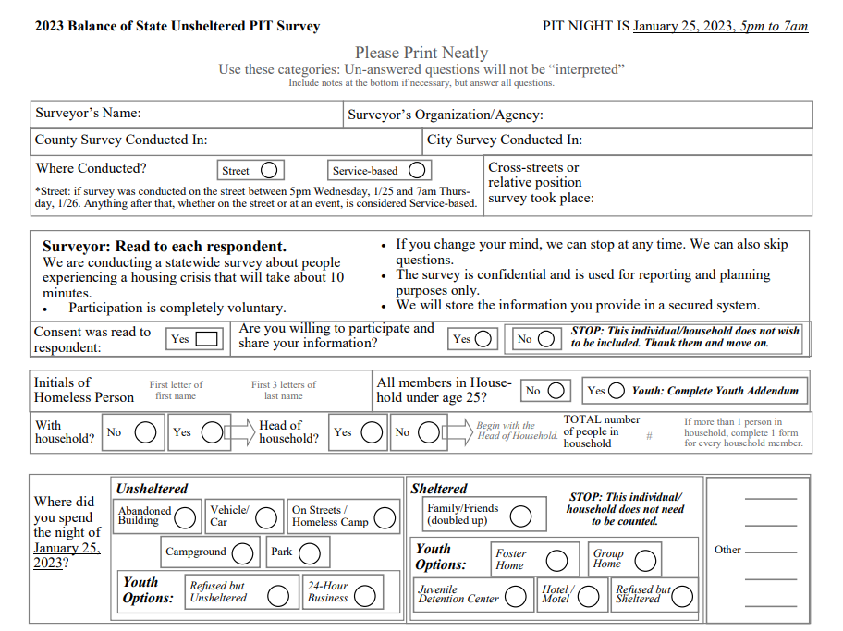
General Survey
Survey
This is the 2023 paper version of the Point in Time Count Survey

Slide 53
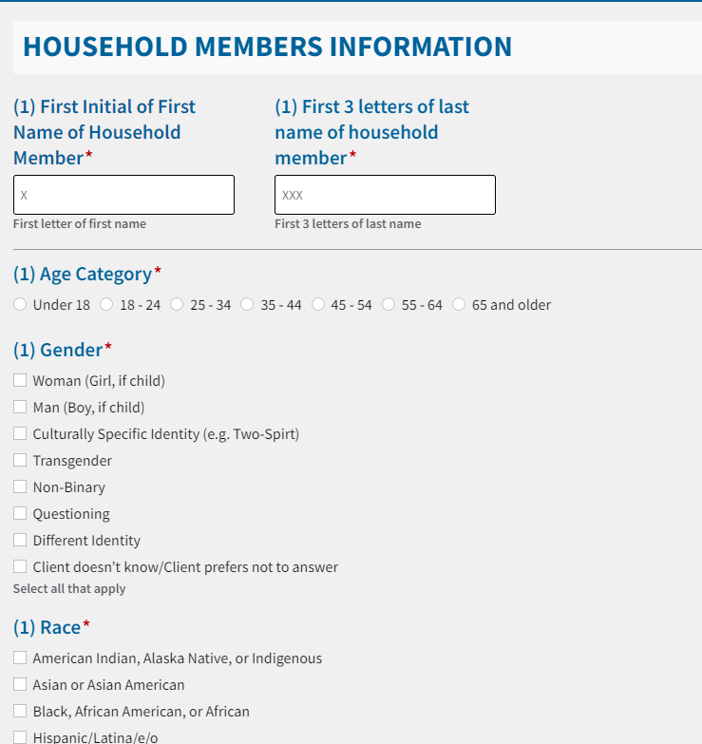
Survey
Online Survey
Additional Household Member Survey
Complete this form for each member of the Head of Household’s family.
*Note- these are only the first few question of the Additional Household member form. Form is similar to original survey.

Slide 54
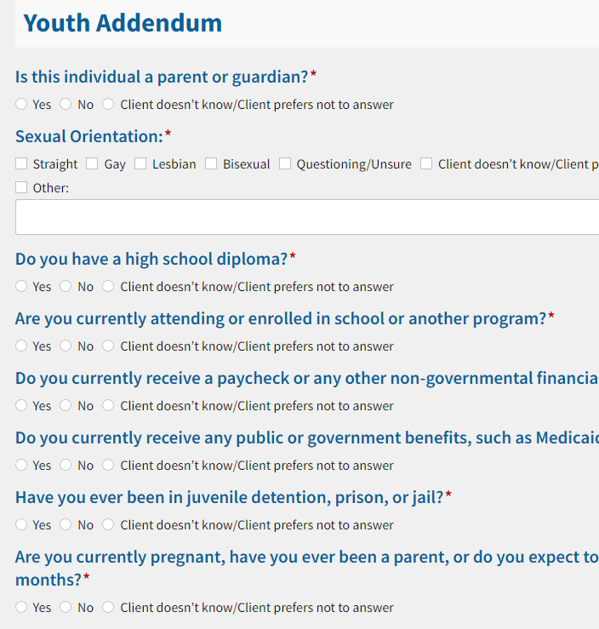
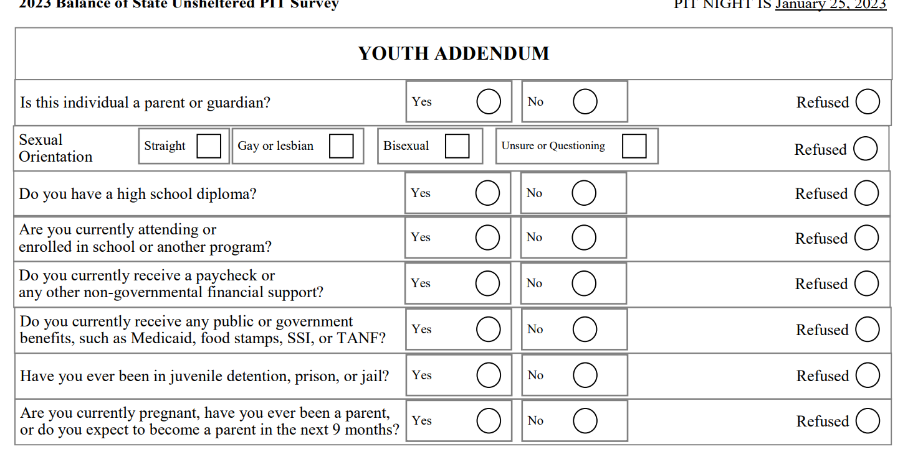
Online Survey
Survey
Youth Addendum Survey
Use with anyone under 25 who is not accompanied by anyone who is over 25. Start with the general survey form, then turn to this one AFTER you’ve asked the general survey form questions.
Paper Version

Slide 55
Survey
Survey Reminders
Some survey questions are difficult to ask and answer, volunteers should ask all questions instead of skipping. Only skip questions when the survey participant declines to answer.
All questions should be read to participants. Volunteers should help answer any questions the participant has about the survey.

Slide 56
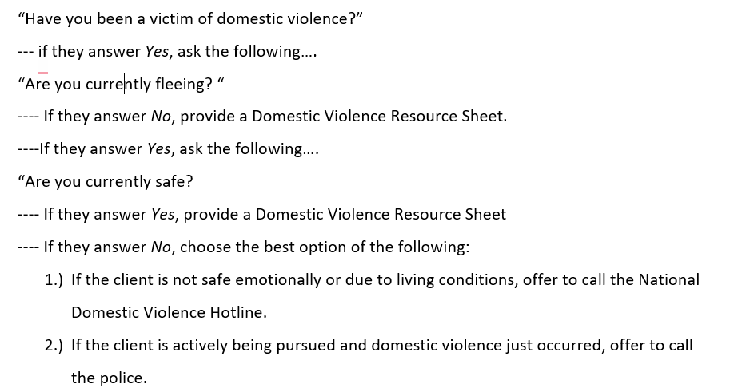
Domestic Violence Process
Survey
DV Script:

Slide 57
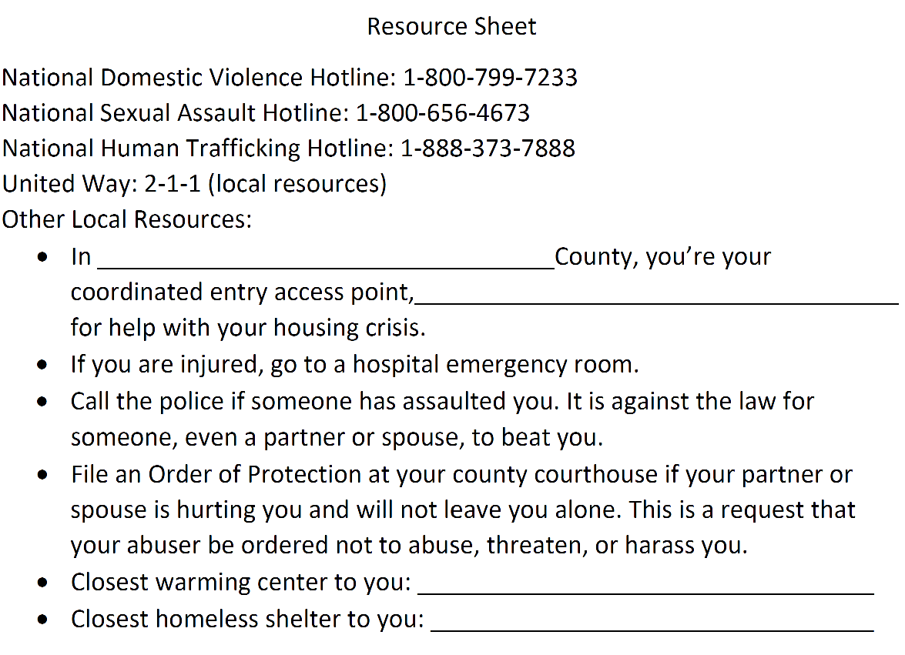
Resource Sheet:
Survey
Complete the sheet to pass out to individuals who may need local resources

Slide 58
PIT Count 101
Resources
Street Count
What to Bring?
Example schedule
Q&A
Service Based Count
Survey
Resources

Slide 59
What to Bring:
You should bring:
Resources
Your vehicle if you volunteered to drive
Weather-appropriate clothing:
Warm, dry clothing that is comfortable to move around in
Don’t over-dress (walking around will generate body heat)
Light or bright colored / reflective clothing
Shoes: warm, sturdy, comfortable, waterproof if possible
Small backpack to carry items and more layers
Pack light – should be light and easy to carry
Cell phone (fully charged); charger or backup battery.
Some form of ID
Eat before you come; bring small snacks if you think it necessary
Plan for how you will get home (especially in urban areas with public transit that might shut down before the PIT count is over)
Energy and compassion; a good set of eyes (visual observation is key)
Agency will Provide:
Paper survey forms (if applicable)
Tablet for mobile surveys (if applicable)
Felt-tipped pens (allow you to write in the cold)
Flashlights and/or headlamp
Clipboard
Snacks before departure
Masks and sanitizer

Slide 60
Schedule for the Night of the Count
Resources
[SAMPLE SCHEDULE OF EVENTS on MM/DD/20XX]
8:30-9 pm
9-9:30 pm
9:30-10 pm
10 pm-2 am
2 am
Arrive at [Meeting Location}
Welcome and overview of the night
Meet with team.
Exchange numbers.
Set a plan.
Get to know each other.
PIT COUNT
Meet with your team lead at designated spot to return PITC survey forms

Slide 61
Resources
Key Contacts
Team Members: Exchange cell phone numbers with others on your team in case you get lost or split into pairs and need to contact each other
01
02
PITC Coordinator/ Key Organization
03
Other Local Resources or Contacts

Slide 62
Resources
Q&A
What questions do you have?
Coordinator Contact Info
Lead Person
Email
Contact Number

Slide 63
Resources
Your PIT Count Team
Ann Gosnell-Hopkins: anngosnell@lexingtonhouseofhope.org
April Redman: callawaycares@outlook.com
PITC Committee Leadership
Notes:
Your PIT Count Team Ann Gosnell-Hopkins: anngosnell@lexingtonhouseofhope.org
April Redman callawaycares@outlook.com

Slide 64
Resources
Additional Opportunities to Get Involved
01
Annual PIT Count Planning Process & Opportunities
02
Additional Volunteer Activities
03
Other Local Resources or Contacts

Slide 65
Additional HUD Resources
Resources
For more information about how the information collected during PIT counts is used and reported, visit the HUD Exchange webpage:
All Annual Homeless Assessment Reports (AHARs)
For information about how PIT count methodologies are standardized nationwide, review the PIT Count Methodology Guide
Local organizations doing similar work / opportunities to volunteer
Thank you for your attention!

