Slide 1
NOTE FOR USE OF THIS PRESENTATION
The following slides are the Volunteer Training Presentation. Some of the information is the same as in previous slides.
Volunteer Training Presentation
Coordinators should change any content in this slide deck as they see fit. Note that any red text in this PowerPoint indicates a place that requires locally-specific content.
Questions or concerns, contact: PIT@moboscoc.org
MO BoS CoC PITC 2024

Slide 2
NOTE FOR USE OF THIS PRESENTATION
The following slides have Red Text that you must edit for your local purposes (per Volunteer PPT).
Slide 19- How will your agency handle Health protocols?
Slide 28- How do you want volunteers to handle incentives?
Slide 32- also about incentives
Slide 36-40- Methodology for counting
Slide 43/44- What are locally specific safety protocol and precautions?
Slide 68- Your schedule for the night of the count
Slide 69- Key Local Contacts for Volunteers
Slide 71-What will the agency provide the volunteers?
Slide 72-Local Agency contact info for volunteers
Slide 73/74- Other volunteer opportunities
MO BoS CoC PITC 2024

Slide 3
CPSEMO: Lead Agency of the MO BoS CoC
Unsheltered Point in Time Count (PITC)
Coordinator Training
MO BoS CoC PITC 2024

Slide 4
05
Agenda
PIT Count 101
21
Street Count
47
Service Based Count
55
Coordinators
62
Survey
73
Resources

Slide 5
PIT Count 101
PIT Count 101
Street Count
What is the PIT Count?
Who is counted in the PIT Count?
Why do we do a PIT Count?
Process Overview
Other FAQs
Health Safety Protocols
Service Based Count
Survey
Resources

Slide 6
What is the Point in Time Count (PITC)?
PIT Count 101
A literal count of all the people experiencing homelessness in our community on a single night (i.e., at a point in time)
Conducted by every community nationwide in the last 10 days of January at least every other year
A “snapshot” of homelessness on this one night in our community

Slide 7
Purpose:
PIT Count 101
“We want to understand the total number of homeless people and some demographic information about them. Because all information is collected on a night, it doesn’t tell us everything about who experiences homelessness in our region, but it does give us a picture of our community, and offers a means of comparing info form this night year after year. Some of the data we collect is required by the U.S. Department of Housing and Urban Development, or HUD, and some of it is information that we as a community want to know to help us understand how well we’re serving people. The required information is ultimately reported to HUD by every community nationwide, so the surveys we ask you to complete with are linked directly to the data we have to report.”

Slide 8
PIT Count 101
Who is counted?
The U.S. Department of Housing and Urban Development’s (HUD’s) definition of “homeless,” for the purpose of the PIT count, includes two main types of homelessness:
Unsheltered: Individuals or families whose primary nighttime residence is a public place not meant for human habitation
Sheltered: Individuals or families residing in a place dedicated to serving people who would otherwise be unsheltered

Slide 9
PIT Count 101
Who is counted?
Unsheltered PIT Count
Sheltered PIT Count
Street & Service Based Counts
Parks
Cars
Abandoned building
Bus or train station
Airport
Camping ground
Parking Lot
Emergency shelters (including those using hotel and motel vouchers)
Transitional housing
Safe Havens
Today’s training will focus on the Unsheltered Count

Slide 10
PIT Count 101
Note to Coordinators:
For any pop-up Shelters, reach out to your ICA System Administrator
HMIS System Administrators
Region 1, 6,7,8,9: Taylor Cummins taylor.cummins@icalliances.org
Region 2,3,5 Diana Kilguss diana.kilguss@icalliances.org
Region 4,10 Krystal Searcy krystal.searcy@icalliances.org
Sheltered PIT Count
Emergency shelters (including those using hotel and motel vouchers)
Transitional housing
Safe Havens

Slide 11
PIT Count 101
Why do we do a Point in Time Count?
It is about people
It is about data
It is about compliance
To help our community understand what resources we need and strategize the best ways to use them to end homelessness
To measure and monitor trends and changes in homelessness on local and national level
To comply with federal regulations and grant requirements

Slide 12
PIT Count 101
Frequently Asked Questions
Why in the winter?
Does it have to be at night?
How do we conduct an unsheltered PIT Count?
When do we count?
Who do we count?
Who do we NOT count?

Slide 13
PIT Count 101
FAQ: Why does the Point In Time Count take place
during the winter months?
Same timeframe for every community ensures consistency across the U.S.
Same timeframe year after year ensures that trends are monitored appropriately
Set for a night in winter because then each CoC is likely maximizing its resources to serve people's needs. Thus, this timing can provide a more precise picture of who is unable to access emergency shelter or other crisis response assistance.
End of the month to ensure that people who can only pay for temporary housing for part of the month are generally included in the count. For example, some people can afford to stay in a motel, but only for the first few weeks after receiving their public benefits payment at the beginning of the month

Slide 14
PIT Count 101
FAQ: Why do we have to do the PIT count at night?
The PIT count is a count of where people are sleeping on the night designated for the count. If we sent volunteers out before nighttime, we would not get the most accurate data for a few reasons.
There may be people who will sleep in unsheltered locations who are not yet out for the night.
We want to capture people’s actual sleeping arrangement, not where they plan to sleep at a future time.
We don’t want to only interview people who “look” the way many people assume those experiencing homelessness must look, which is hard to do during daylight hours.
Notes:
“Many people wonder why we conduct the PIT count at night. In short, it’s because our data quality won’t be as good if we do it, for instance, in the afternoon or evening and ask about where people will sleep that night. There are a few reasons for this:
First, there may be people who will sleep in unsheltered locations who are not yet out for the night. Perhaps they work during the day or spend daylight hours elsewhere for another reason.
Second, we do not want to ask people where they plan to sleep at a future time, even if that time is only a few hours away. Plans can change, and we want to make sure we’re getting the most accurate information possible.
Finally, many people who meet HUD’s definition of experiencing homelessness may not “look” the way many people assume those experiencing homelessness must look. So, during daylight hours, when it would be impossible to survey every single person who’s out and about, we might overlook them. At night, it is more reasonable to interview everyone who is out, regardless of whether they “look” homeless or not. We’ll talk more about what we mean by this part later on in the training.”

Slide 15
PIT Count 101
FAQ: How do we conduct an unsheltered PIT count?
Street Count
Interview on the Night of the Count (January 24 @5pm-January 25 @7am)
Service -Based Count
In-person events
Phone
after the ‘Street Count’ window is closed
Take place the 7 days following the Count
All surveys are to be conducted in person to person interview style. Do not hand the client a paper copy of the survey to complete on their own
For in person events with incentives, do not force client to complete the survey before gaining access to resources
Notes:
County Coordinators coordinate volunteers to perform the survey and ensure surveys are completed accurately and submitted on-time
Web-based survey helps quickly submit data. Paper forms will be made available if internet service is not available in remote areas.

Slide 16
PIT Count 101
FAQ: When do we count?
January 24, 2023
@5pm
January 25, 2023
@7am
Street Count
Asking: “Where will you sleep tonight?”
Asking: “Where did you sleep last night?”
Service Based Count
After 7am on the 25th to 31st
Asking: “Where did you sleep on Wednesday night?”
*Note it is not recommend to ask interviewees more that 2-3 days after the count to complete a survey, as they may not remember correctly and could skew the data collection

Slide 17
PIT Count 101
FAQ: Who to count?
Unsheltered Homeless Definition
“Individuals and families with a primary nighttime residence that is a public or private place not designed for or ordinarily used as a regular sleeping accommodation for human beings, including a car, park, abandoned building, bus or train station, airport, or camping ground”

Slide 18
PIT Count 101
FAQ: Who to NOT count?
People engaged in dangerous activities
Your safety is number one priority
People residing in institutions (e.g. jails, juvenile correction facilities, foster homes, hospitals, in-patient treatment centers)
“Doubling Up/ Couch Surfing”:
Survey will end at question, “Where did you sleep the night of the PITC?” if the answer is “couchsurfing/doubling up”

Slide 19
PIT Count 101
FAQ: What constitutes sheltered vs unsheltered?
Clients provided with planned sleeping arrangement for the night, i.e. provided a cot for the night = sheltered
Clients given shelter for the night with not planned, such as sleeping in a church pew, floor or chair = unsheltered
Hotel/Motel
If a location is being paid for by a social service agency or other third parties, notify ICA as soon as possible, as they may be counted on the Sheltered Count.
Individuals that are self-paying for a hotel room should not be counted as homeless.

Slide 20
Health Safety Considerations
PIT Count 101
Keep in Mind: We are working with vulnerable populations. Homelessness and health challenges are connected, with many health conditions caused or worsened by the lack of housing.
If you are showing symptoms, stay home
Refer to local health dept for recommendations
Please bring a mask, just in case and use as needed
We will be prepared with extra masks and hand sanitizer
Carry extra disposable masks for interview with individuals
Adhere to social distancing throughout the count. This includes teammates and clients.
Volunteers considered high risk will be assigned to low risk duties.

Slide 21
PIT Count 101
Street Based Count
Street Count
The Interview
Locations
Safety
Service Based Count
Survey
Resources

Slide 22
How to Conduct a Survey
Street Based Count
Remember that you are speaking to highly vulnerable people and asking some very sensitive questions.
Always lead with respect for the person you’re speaking with and respect for their dignity.
Everyone has the right to refuse to answer any or all of your questions.
Ask all questions, unless the person has already given the answer to the question over the course of your conversation.
Always ask questions as they are written; do not ask questions in a way that shows you think you already know the answer.
Example: Ask: “How do you identify your gender?” Do not ask: “You’re male, right?”

Slide 23
Survey Reminders
Street Based Count
Interview clients in a person-to-person format; do not give the client the paper survey to complete on their own
Interviews give more information about unsheltered homeless individuals and families
If the person you are interviewing is ‘couch surfing’ the online form will end. If you are interviewing in person, politely end the survey if they answer “yes”
Better data helps avoids duplication and better differentiates people who are chronically homeless and those who are not

Slide 24
Step-by-Step Guide to Conducting Interviews
Street Based Count
Step 1: Approach & Introduction
Approach the person and introduce yourself
Ask if the person has a few minutes to answer some questions
Keep in mind:
Individuals sleeping outside may be dealing with active addiction, mental health concerns, and significant trauma histories. Do not sneak up on or startle people. Never shine flashlights in people’s faces.
Maintain eye contact (if possible) and an open stance with your hands visible. Use a tone of voice that’s approachable. Speak slowly, be polite, and don’t shout.

Slide 25
Step-by-Step Guide to Conducting Interviews
Street Based Count
Example:
Hi, my name is [name]. We’re out here trying to talk to individuals who might not have a safe place to sleep tonight. Do you have a safe place to sleep tonight? Do you know where I might find some people around here who don’t?

Slide 26
Step-by-Step Guide to Conducting Interviews
Street Based Count
Step 2: Explain what you’re doing & get consent
Explain why you’re there
Explain to volunteers how you want them to handle any incentives you’re offering
If they consent to answering your questions, continue with the interview. If they don’t, thank them for their time.

Slide 27
Step-by-Step Guide to Conducting Interviews
Street Based Count
Example:
We’re conducting a survey, and your participation will help the community provide better services and resources for people who might not have a safe home to sleep at night. It’ll take about 4-5 minutes, you don’t have to answer any questions you don’t want to answer, and it’s all anonymous – meaning your name won’t be used. Are you willing to answer these questions?

Slide 28
Step-by-Step Guide to Conducting Interviews
Street Based Count
Step 3: Conduct the interview using the survey form
Go through each question in the survey form.
Remember: people have the right not to answer all questions!
Add any notes that may be helpful
Example: If a person says that they have their own apartment, but they’re sitting on a bench outside of a 24-hour grocery store at 2:00 am with what appear to be all of their belongings, write down that you think there may be a discrepancy in what they are saying vs. where they will sleep that night.

Slide 29
Step-by-Step Guide to Conducting Interviews
Street Based Count
Step 4: Closing the interview
Thank the person for their time
Refer them to any services or resources they may have asked about or may need. Offer everyone a resource sheet / contact card
Give them the incentive

Slide 30
Step-by-Step Guide to Conducting Interviews
Street Based Count
Step 5: Recording what you heard and observed
Walk away from the person interviewed to a safe place
Take a few minutes after your conversation to double check that you’ve completed the whole survey form
Include any additional notes or details
Make sure everything you have written is readable

Slide 31
Survey Accuracy
Street Based Count
Ensure that you complete the survey with the client
Compete all survey questions as completely as possible
Utilize the survey instruction document to help guide the conversation and ensure a properly completed survey
If people decline to answer a question or don’t know, indicate as such
If they state that they were ‘couch-surfing’ or staying with someone, politely end the survey after this question.
When completing a survey, please take down notes and be as detailed as possible without making assumptions
If this survey is conducted via phone by a social service agency with clients they know to be homeless, please indicate as “Service-Based”
Do not force clients to complete the survey prior to them gaining resources/incentives

Slide 32
Where to
Go: Planning
Street Based Count
Known encampment locations
Parking lots of large stores
Wooded unkempt areas, i.e. river banks (as safe)
Parks, overpasses, etc (as allowed)
24 hour locations (laundromats, convenience stores, etc)
Compile a list of locations with the help of other local service providers
Volunteers should only travel to and enter locations that are safe and legally allowed access to.
Thorough Pre-planning should be done to Identify all locations. Contact formerly homeless, local law enforcement, hospitals, and school district liaisons.

Slide 33
Where to
Go
Street Based Count
Outdoor public places:
Parks, Public benches, Bus stops
Doorsteps of businesses that are closed for the night
Encampments
Parked cars
Indoor places:
24-hour businesses (e.g., grocery stores, McDonald’s, Wal-Mart, convenience shops)
Bus, train, & metro stations, Local VA coverage, VSO, VFW, DAV, SSVF, American Legions, Local Veteran community groups, Libraries- Flyers
Ask folks who you see out and about if there is anywhere else you should go
Employees at businesses that are open
Law enforcement (e.g., sheriffs and local police)
Others you interview

Slide 34
Where to Go: Known Locations
Street Based Count
Volunteers assigned to specific locations in areas known to have unsheltered individuals.
Coordinators must be aware of infringing on client’s privacy. When creating and passing out maps, inform volunteers that the location of individuals is confidential and not to be shared.
Coordinator Tips:
01
Volunteers will walk or drive to specific location within a given area.
03
Ensure volunteers are knowledgeable of safety concerns for specific areas
02
Provide detailed instructions of where to go & how to get there
04
Show volunteers where to go by providing maps

Slide 35
Where to Go: Hotspot or Known Locations
Street Based Count
You will be provided:
Detailed maps AND instructions for where volunteers are expected to go.
are they responsible for the people within view of where these points are?
should they survey others they encounter en route?
If they finish early, should they begin to survey the rest of the area or wait?
Reminder not to count people outside of their assigned geography, as other volunteer groups will cover those areas.
Instructions on what information you expect to hear back from people.
Do you want them to highlight on a paper map the exact route they took?
Do you want to know if they didn’t make it to any particular location they were supposed to reach?
Do you want to know if they stopped any extra places?

Slide 36
Where to Go: Hotspot or Known Locations
Street Based Count
Volunteers assigned to specific locations in areas known to have unsheltered individuals.
Coordinators must be aware of infringing on client’s privacy. When creating and passing out maps, inform volunteers that the location of individuals is confidential and not to be shared.

Slide 37
Where to Go: Complete Coverage or Full Census of Random Sample Areas
Street Based Count
Complete coverage or full census of random sample areas: where volunteers will walk or drive on all streets within a given area. The full geographic area is shown here with blue lines.
You will be provided:
Detailed maps AND instructions for which side of the street they will be responsible for.
Reminder not to count people outside of their assigned area, as other volunteers will cover those.
Instructions to cover whole area (i.e., all streets) either on foot or by car.
Instructions on what information you expect to hear back from them on where they went
Do you want them to highlight on a paper map the exact route they took?
Do you want to know if they didn’t make it to any particular location they were supposed to reach?
Do you want to know if they stopped any extra places?

Slide 38
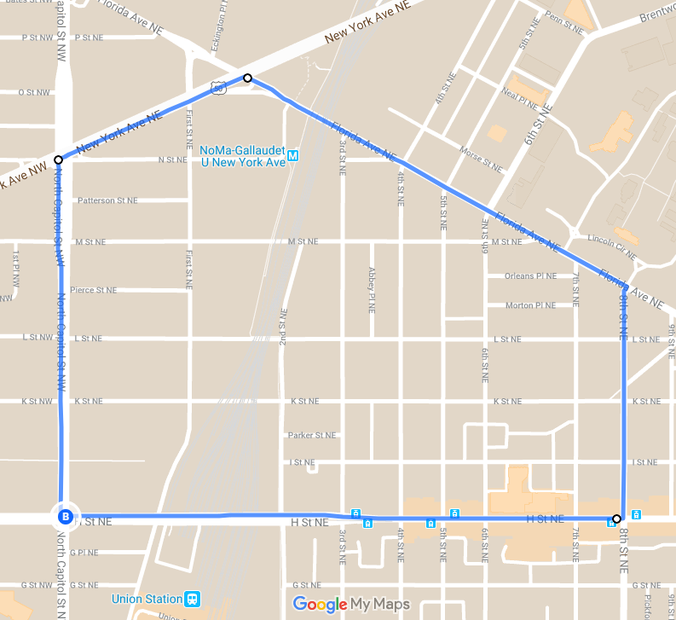
Sample Map: Complete Coverage or Full Census of Sample Areas
Street Based Count
This map of a neighborhood in Washington, D.C. is meant to serve as an example.
When showing volunteers maps of the geographic areas you want them to cover, include:
any areas you want volunteers to avoid (are there safety concerns?),
any known locations you definitely want them to visit (i.e., hotspots),
any specific walking or driving routes you want them to take.
instructions for which side of the street volunteers will be responsible for. (e.g., on this map, are they responsible for one side and another volunteer team will cover the other? Or are they responsible for both sides of their blue-lined streets?)
Coordinators must be aware of infringing on client’s privacy. When creating and passing out maps, inform volunteers that the location of individuals is confidential and not to be shared.

Slide 39
Who to Interview?
Street Based Count
It is not always possible to determine if someone is experiencing homelessness based solely on how they look.
Consider:
- Where do you see the person?
- What is the person doing?
- What time is it?

Slide 40
Street Based Count
Pitfall: Making assumptions about who to interview using stereotypes of what homelessness looks like.
Who to Interview?
Best practice: Approach everyone you see. You can use a soft, non-confrontational introduction that’s easy to reverse course if the person is not experiencing homelessness.

Slide 41
Who to Interview?
Example:
Street Based Count
Hi, my name is [name]. We’re out here trying to talk to individuals who might not have a safe place to sleep tonight. Do you have a safe place to sleep tonight? Do you know where I might find some people around here who don’t?

Slide 42
Should I wake someone who is sleeping?
Street Based Count
You can, but remember: your safety comes first.
Take in your surroundings before you attempt to wake someone.
If you choose to do so; follow these practices:
-Do not touch them.
- Use your voice to wake them.
- Speak slowly and calmly.
- Remember that they may be disoriented when waking up.

Slide 43
Should I wake someone who is sleeping?
Street Based Count
You can, but remember: your safety comes first.
- Do not force them to answer your questions.
- If they do not respond, but appear to be breathing, leave them be.
Always, thank them for their time, apologize for waking them, and complete the appropriate form.
If someone appears to be sleeping in a dangerous situation, follow your emergency protocol to alert the appropriate people. Do not wake them on your own.

Slide 44
Street Based Count
Safety in Numbers
Keep Your Distance
Be Aware
Stay in the Light
Stay on your Feet
You should ALWAYS be with at least one other person.
Keep an appropriate conversational distance from those you are interviewing.
Maintain awareness around you – where other people are, exits, etc.
Stay in places that are lit. If you use a flashlight, do so respectfully (i.e., don’t shine it in anyone’s face).
Remain standing. It’s okay to squat down to speak with someone who is sitting or lying on the ground, but always maintain your balance.
Your Safety is # 1 Priority
No Transporting
Prioritize YOU
Local Emergency
Local Precautions
Do not transport anyone other than volunteers in your personal vehicle
Prioritize your own safety.
If you don’t feel safe with someone or going somewhere, don’t go.
Locally-specific instructions for who to call in case of emergency
Locally-specific precautions.

Slide 45
Safety of those you Interview
Street Based Count
Health & Safety Concerns (especially if it’s cold outside)
Notice if:
They have layers under and on them to keep them warm enough
They’re dry (hypothermia concerns)
You can see the rise and fall of their breathing
Add your local protocol for what to do in your community if an individual is in distress, seeking immediate shelter, needs more layers, etc.
ALWAYS call 9-1-1- if you are or someone else is at risk of danger

Slide 46
Privacy and Confidentiality
Street Based Count
You will be dealing with individuals in vulnerable positions.
All information obtained during the Count is confidential and is to only be used for the purpose of counting unsheltered persons.
All PIT Count volunteers must sign the ‘Volunteer Release and Confidentiality Agreement’ or complete a digital version via link provided below
Confidentiality Volunteer Form or Online Link

Slide 47
PIT Count 101
Service Based Count
Street Count
When?
How To
Using the Priority List
Service Based Count
Survey
Resources

Slide 48
Service Based Count
What is “Service Based Count” ?
It’s a Time Period
The Service Based Count takes place after the night of the count closes. The “Street” Count focuses on the night of the designated count from 5 pm to 7 am. After 7 am and 7 days after the night of the count is the time period of the Service Based Counting. Interviews and surveys continue, focusing on where the client was on the night of the PITC.
It is Events
Often the Service Based Count is executed through events. From Project Homeless Connect to simple coffee and doughnuts, organizations invite clients to events to gain services, resources and complete the PITC survey

Slide 49
Service Based Count
The Rundown:
Often utilized by organizations that do not provide overnight beds but may work with people experiencing homelessness
Service based count is unlikely to count persons who are unable or unwilling to access services
May only be conducted in 7 days following the count
Must include an interview that confirms the person was homeless on the night of the count
CE leads should make use of the PL to confirm status of individuals on the night of the count.

Slide 50
Service Based Count
Use of the Priority List for the Count
Regional Coordinators should contact CE Leads to make use of the PL to confirm status of individuals on the night of the count.
Ways to make use of the PL for PITC:
Only contact individuals that are/were in a area not meant for human habitation
Divvy up list at a regional case conferencing meeting
Ensure that only agencies with MOUs have access to client contact and information
Lean on agency relationships/contact with client for reach out
Divide PL by County Leads to ensure accurate and local contact
Notes:
May only be conducted in 7 days following the count
January 26-February 1
Best practice is to conduct service based counts the day of or day after
Breakfast and working with local community– how do you organize that? Project Homeless connect the day after the count. Start planning in Sept. Funding– get donations from area businesses that want to have homelessness helped. A one stop shop– for all needs of an unhoused person. Non-profit options for costs. Area extensions office and brings a healthy lunch. Key resources– local health dept (vaccines and flu shots, WIC info, ) Social Services, Senior Services, License Office, 4-5 employment opportunities, area churches, income based medical facility, Diaper resource center, pregnancy resource center, VA, chiropractor, Eye exams, laundry vouchers, ISSUE: transportation from other counties to the event
Doesn’t have to be called project homeless connect. (it's a sign up, trademark thing)
Doesnt have to be from a service provider, it could just be an event. Breakfast, backpack give away, etc.

Slide 51
Service Based Locations
Service Based Count
As a coordinator, you are empowered to reach out to any and all of these types of locations that may have contact with unhoused individuals.
Encourage any interested parties to complete the training and confidentiality agreement, complete surveys with individuals and send them back to you to input online.
School districts (contact the homeless liaison)
Drop-in centers
Street outreach teams
Soup kitchens
Warming shelters
Day shelters
Food pantries
Community Action Agencies
Mainstream services locations
Libraries
Hospitals/health care settings
Day labor sites
Employment centers
Churches/religious institutions

Slide 52
Service Based Example
Service Based Count
Volunteers know of a food pantry that takes place the last Thursday during January at a local church. A week prior to the count, they explain the purpose of the Point-in-Time Count and ask if food pantry staff would be willing to watch the training webinar and use the online survey tool to interview clients. The food pantry staff agree to survey attendees with the Point-in-Time Count survey.

Slide 53
Service Based Follow Up – Phone
Service Based Count
Surveys can be completed over the phone. Coordinators are encouraged to reach out to known unhoused clients via phone to ensure they are accounted for the night of the count.
Can be utilized by organizations that do not provide overnight beds contact clients during the count to confirm housing status and conduct the survey
The client must report they were homeless on the night of the count
Less preferred than other methods

Slide 54
Service Based Example– Phone
Service Based Count
A caseworker regularly works with three clients who live in unsheltered situations. During the service-based count period, the caseworker contacts them over the phone and asks them to participate in the Point-in-Time Count survey.
One client reports they were able to stay with friends or family on the night of count, so the caseworker does not complete the survey with them.
The second client reports they slept in a tent at a campground on the night of count, so the caseworker completes all sections of the survey as completely as possible.
The caseworker was unable to contact the third client during the service-based count period, so that client’s information was not included in the PIT Count.

Slide 55
Coordinators
Assist in marketing efforts with agencies in your region (with PITC committee material and support).
Keep record from the Point in Time Count for 1 year (including, but not limited to Volunteer Release Agreements and surveys), as well as send Lead Agency all Volunteer Release Agreements.
Coordinate with the Lead Agency to gain records of volunteer record and agreements. Please ensure that you communicate with the Lead Agency on organization participation for ESG/MHTF/NOFO grant scoring expectations. Template will be provided.
Responsible for ensuring all counties have a designated County PIT Coordinator.
Facilitate two meeting discussions (as part of the regular business meeting or stand alone if needed) to share information with all County PIT Coordinators, with one within 7 days of the Count.
Participate in the PITC Committee meeting as available (review the meeting minutes when not available).
Ensure the County PITC Coordinators are able to lead the training meetings, with the support of the PITC committee.

Slide 56
Coordinators
Assist in marketing efforts with agencies in your region (with PITC committee material and support).
Keep record from the Point in Time Count for 1 year (including, but not limited to Volunteer Release Agreements and surveys), as well as send Lead Agency all Volunteer Release Agreements.
Coordinate with the Lead Agency to gain records of volunteer record and agreements. Please ensure that you communicate with the Lead Agency on organization participation for ESG/MHTF/NOFO grant scoring expectations.
Responsible for ensuring all counties have a designated County PIT Coordinator.
Facilitate two meeting discussions (as part of the regular business meeting or stand alone if needed) to share information with all County PIT Coordinators, with one within 7 days of the Count.
Participate in the PITC Committee meeting as available (review the meeting minutes when not available).
Ensure the County PITC Coordinators are able to lead the training meetings, with the support of the PITC committee.

Slide 57
Coordinator- Process Timeline
Coordinators
Use this timeline as a guide to set dates for your agencies’ planning and execution of the PITC.
Goals for the Week
3 Weeks Out and Earlier- Reach out to organizations for resources, help in planning, knowing locations and volunteers. Recruit for all aspects of the count- organizations, resources, volunteers, leaders, etc.
2 Weeks Out- Host a planning event for organizations involved, divvy up areas, have all location coverage planned, have PITC schedule prepared, gather/ prepare supplies
1 Week Out- Gather needed materials and prep for training. Host training for Volunteers, gather supplies, prep PIT cards, volunteer packets, maps, hygiene kits or other hand outs for the PITC.
Week of: Last meeting for Preparation of the count, last minute trainings, supplies prep, review expectations with those in leadership roles on the agency level.
Week Post- PITC County Coordinators input data from Paper surveys, end of Service Based and Sheltered Count

Slide 58
Example
Timeline
JANUARY
Coordinators
Sun | Mon | Tue | Wed | Thur | Fri | Sat
 |  |  | POINT IN TIME COUNT
Organization and Volunteer Recruitment
Learn known locations where individuals gather
Use this timeline as a guide to set dates for your agencies’ planning and execution of the PITC.
These are estimations of dates and time to prepare for the PIT. Feel free to adapt and prepare for the Point in Time Count as you see fit!
Continue to recruit volunteers
Create Volunteer Maps, gather supplies
Send Reminders
Preplanning meeting
Prep for Volunteer training
Volunteer Training-
collect Volunteer Release forms at this time
Prep Incentives
Last minute trainings & prep
Service Based Count (7 days after)
Last meeting with leadership
Service Based Count Days

Slide 59
Coordinator Record Keeping
Coordinators
As a coordinator of the Point in Time Count, please keep accurate records of what organizations and agencies are working with you in the count.
Keep track of:
-Planning
-Meetings
-Volunteers to Count
Ensure all involved organizations:
-Participate in training
-Sign confidentiality Release
-Complete Post PIT Survey
Send all of this information to the Lead Agency & Leadership of the PITC Committee. Keep records for at least a year.

Slide 60
Preplanning for Full County Coverage
Coordinators
Reach out to community agencies , to ensure best use of resources
Contact formerly homeless individuals and families for ideas on where to look
Contact local law enforcement to help locate areas where homeless individuals and families stay
Contact local hospitals and talk with the social worker on staff
Compile a list of locations with the help of other local service providers
Contact school district liaison for ideas on where to locate homeless families (assure them privacy is respected)
Thorough Pre-planning should identify all locations. Contact formerly homeless, local law enforcement, libraries, churches, hospitals, and schools

Slide 61
Coordinator Reminders
Coordinators
Volunteer recruitment, training and coordination are the responsibility of county coordinators
Ensure that you have open communication with all coordinators, the Lead Agency and PITC leadership
Surveys must be complete or we can not use data for HUD quality purposes (if the participant declines to answer, indicate as such)
Be sure to impress this importance to volunteers and coordinators
Prepare planning meetings with coordinators, agencies planning events and/or street counts, etc.
Ensure all participants complete the Volunteer Confidentiality Agreement
Provide the training materials as put together by the Lead Agency, including the Volunteer Packet and the Refresher Hand Out
Emphasize the importance of personal safety above all.

Slide 62
PIT Count 101
What’s in the Survey?
Street Count
Service Based Count
Survey
Resources

Slide 63
Survey
Online vs Paper
Online Portal
Institute for Community Alliances (ICA) has an online portal for surveying clients. This is accessible with internet or mobile service, depending on location. It is preferred that the online portal is used. Any paper surveys must be input to this portal by the end of the Service Based period of the PITC.
Paper Form
A paper version of the survey is available for rural areas where internet access may be not be possible. Ensure that you adhere to all expectations when using the paper copy to interview clients. Make sure the writing is legible, as these will be input to the online portal.

Slide 64
The Surveys
Survey
General Survey
For all people or households who are willing and able to answer your survey questions.
Youth Addendum Survey
For use in addition to the general survey form for individual people under 25, or for households headed by someone under 25, who are willing and able to answer your survey questions.
Additional Household Members Survey
Complete this form for each member of the Head of Household’s family.
*Note different in paper version

Slide 65
Survey
General Survey
Always start with this form (we’ll talk about special considerations for folks who don’t want to or can’t complete the survey with you for some reason)
Complete one general survey form per household
Online Survey Link
Paper Survey Link

Slide 66
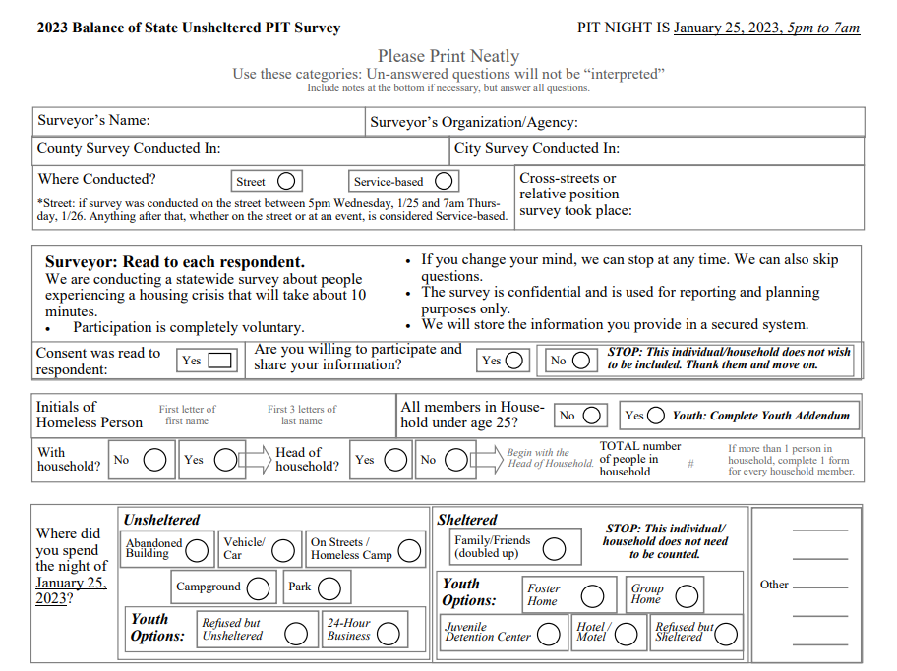
General Survey
Survey
This is the 2023 paper version of the Point in Time Count Survey

Slide 67
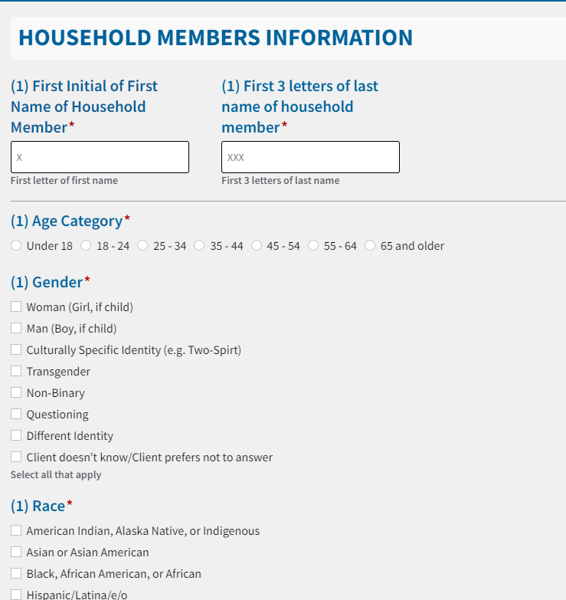
Survey
Online Survey
Additional Household Member Survey
Complete this form for each member of the Head of Household’s family.
*Note- these are only the first few question of the Additional Household member form. Form is similar to original survey.

Slide 68
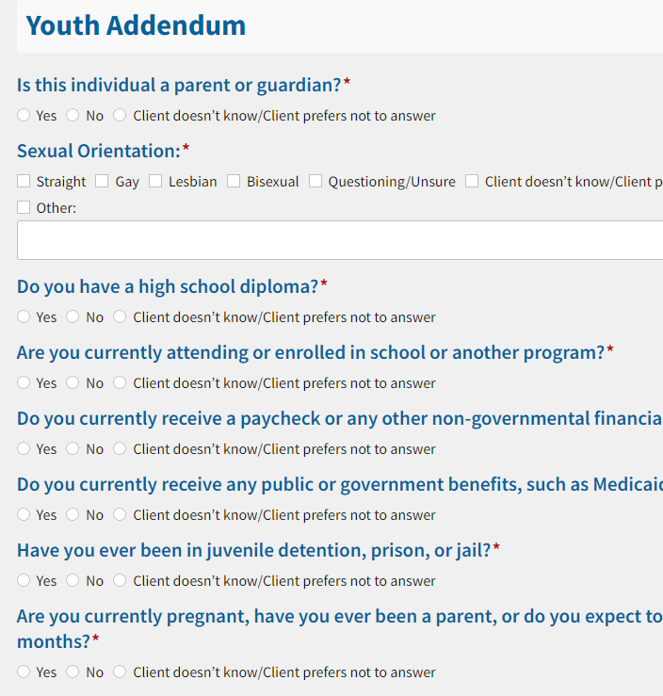
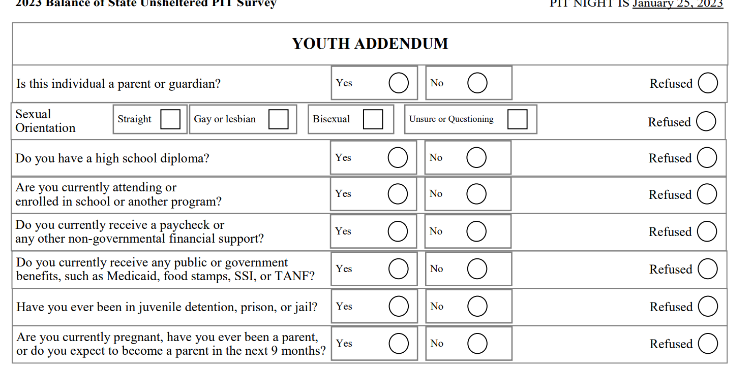
Online Survey
Survey
Youth Addendum Survey
Use with anyone under 25 who is not accompanied by anyone who is over 25. Start with the general survey form, then turn to this one AFTER you’ve asked the general survey form questions.
Paper Version

Slide 69
Survey
Survey Reminders
Some survey questions are difficult to ask and answer, volunteers should ask all questions instead of skipping. Only skip questions when the survey participant declines to answer.
All questions should be read to participants. Volunteers should help answer any questions the participant has about the survey.

Slide 70
Survey
Survey Changes for 2024
Updates to align to data standards, including:
Gender
Combining Race/Ethnicity
“Client Refused” changed to Client Prefers Not to Answer
Added question to ascertain parenting youth households-

Slide 71
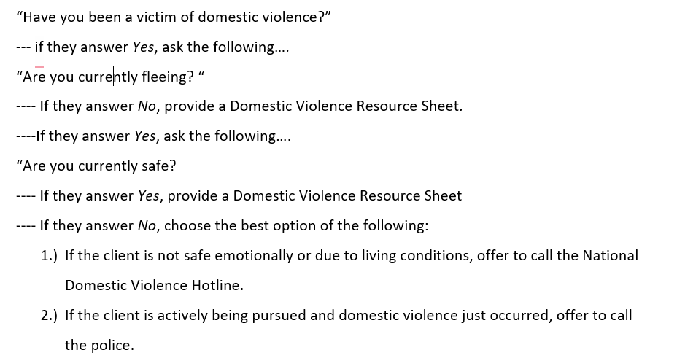
Domestic Violence Process
Survey
DV Script and Resource Sheet:

Slide 72
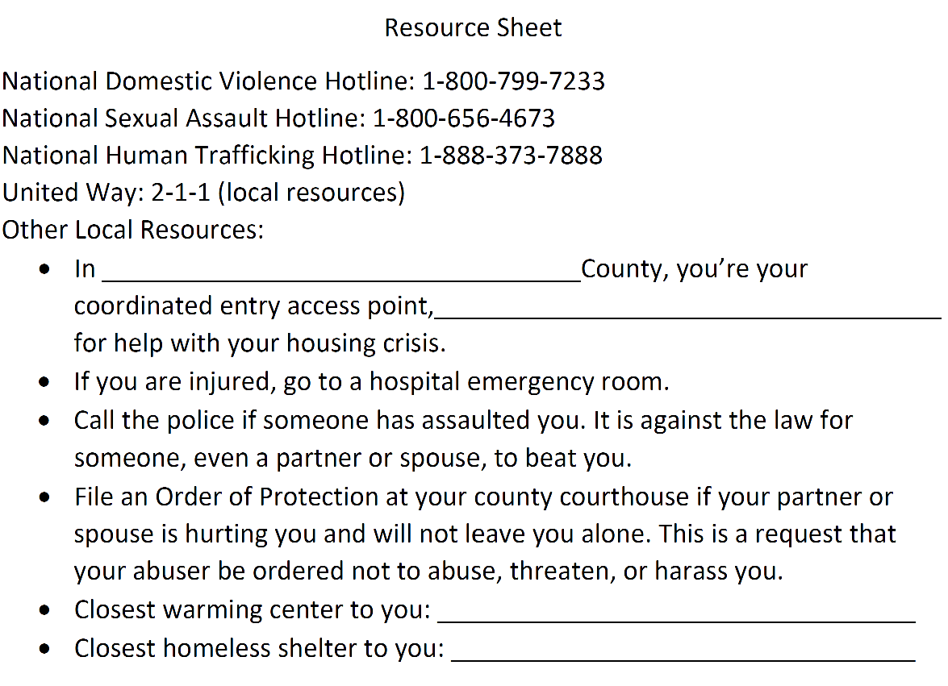
DV Script and Resource Sheet Continued:
Survey
Complete the sheet to pass out to individuals who may need local resources

Slide 73
PIT Count 101
Resources
Street Count
What to Bring?
Example schedule
Q&A
Service Based Count
Survey
Resources

Slide 74
Schedule for the Night of the Count
Resources
[SAMPLE SCHEDULE OF EVENTS on MM/DD/20XX]
8:30-9 pm
9-9:30 pm
9:30-10 pm
10 pm-2 am
2 am
Arrive at [Meeting Location}
Welcome and overview of the night
Meet with team.
Exchange numbers.
Set a plan.
Get to know each other.
PIT COUNT
Meet with your team lead at designated spot to return PITC survey forms

Slide 75
Resources
Key Contacts
Team Members: Exchange cell phone numbers with others on your team in case you get lost or split into pairs and need to contact each other
01
02
PITC Coordinator/ Key Organization
03
Other Local Resources or Contacts

Slide 76
Resources
Your PIT Count Team
Ann Gosnell-Hopkins: anngosnell@lexingtonhouseofhope.org
Edwin Cooper: Edwin.Cooper@dmh.mo.gov
Lead Agency (CPSEMO): pit@moboscoc.org
PITC Committee Leadership

Slide 77
What to Bring:
You should bring:
Resources
Your vehicle if you volunteered to drive
Weather-appropriate clothing:
Warm, dry clothing that is comfortable to move around in
Don’t over-dress (walking around will generate body heat)
Light or bright colored / reflective clothing
Shoes: warm, sturdy, comfortable, waterproof if possible
Small backpack to carry items and more layers
Pack light – should be light and easy to carry
Cell phone (fully charged); charger or backup battery.
Some form of ID
Eat before you come; bring small snacks if you think it necessary
Plan for how you will get home (especially in urban areas with public transit that might shut down before the PIT count is over)
Energy and compassion; a good set of eyes (visual observation is key)
Agency will Provide:
Paper survey forms (if applicable)
Tablet for mobile surveys (if applicable)
Felt-tipped pens (allow you to write in the cold)
Flashlights and/or headlamp
Clipboard
Snacks before departure
Masks and sanitizer

Slide 78
Resources
Q&A
What questions do you have?
Agency Contact Info
+123-456-7890
www.reallygreatsite.com
hello@reallygreatsite.com
@reallygreatsite

Slide 79
Resources
Additional Opportunities to Get Involved
01
Annual PIT Count Planning Process & Opportunities
02
Additional Volunteer Activities
03
Other Local Resources or Contacts

Slide 80
Additional HUD Resources
Resources
For more information about how the information collected during PIT counts is used and reported, visit the HUD Exchange webpage:
All Annual Homeless Assessment Reports (AHARs)
For information about how PIT count methodologies are standardized nationwide, review the PIT Count Methodology Guide
Local organizations doing similar work / opportunities to volunteer
Thank you for your attention!

